Slide 1

Tweet Intelligence Engine (T.I.E)
An ML-Powered Web App for Predictive Tweet Performance
Welcome to T.I.E — a cutting-edge ML-powered web app designed to revolutionize your Twitter strategy. T.I.E goes beyond basic analytics, leveraging advanced machine learning to predict the potential engagement (specifically, likes) a tweet might receive before you even hit send. This powerful insight empowers content creators and marketers to optimize their messaging for maximum impact.
But T.I.E doesn't stop there. It also offers a robust tweet generation feature, crafting compelling and engaging tweets specifically tailored to your brand's voice and chosen topic. Say goodbye to guesswork and hello to data-driven social media success, ensuring your content truly resonates with your audience and stands out in the ever-evolving digital landscape.

Slide 2
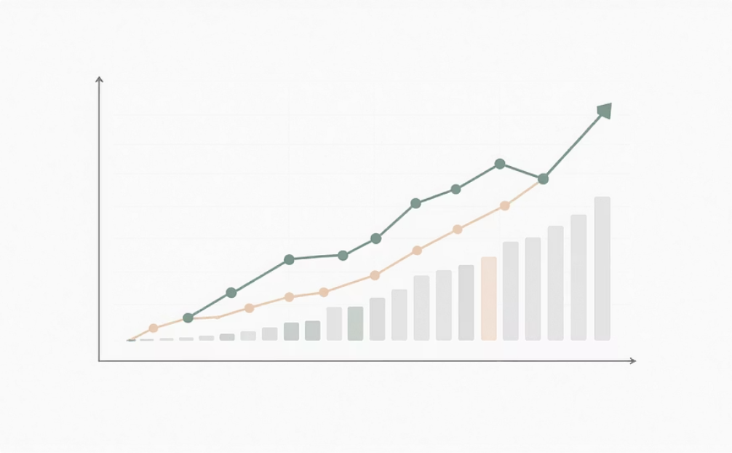

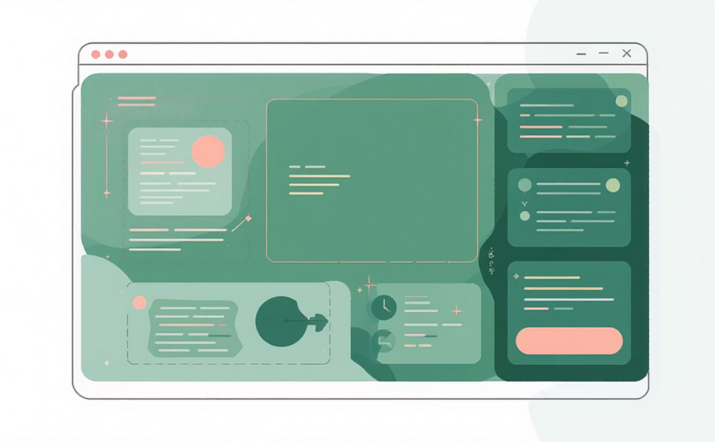
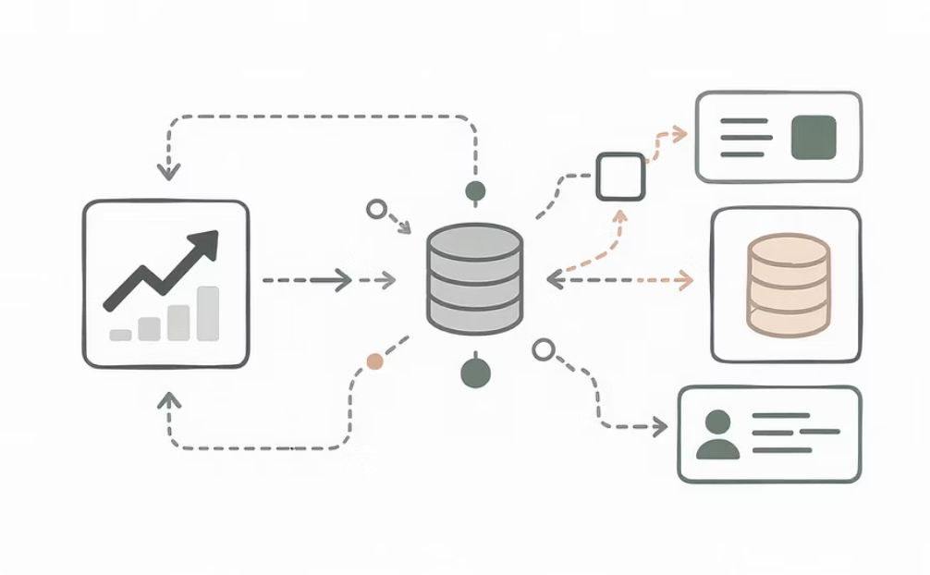
Key Features
Data-Driven Like Prediction
Smart Tweet Generator
Utilizes an ensemble model (Stacking Regressor combining RandomForest, XGBoost, and Linear Regression) for robust like prediction based on content, metadata, and brand context.
Generates dynamic tweet text tailored to brand, tweet type (announcement, question, tip), and optional topics, optimizing for engagement.
Interactive UI
Robust Preprocessing
A modern, elegant user interface built with Flask and Jinja2, featuring light/dark mode toggle, smooth animations, and sophisticated typography.
Cleans input data, extracts advanced features like emoji counts, sentiment analysis (via TextBlob), and encodes categorical variables.

Slide 3
Tech Stack & Libraries
Python Core
Flask Web Framework
The foundational programming language for the entire application, ensuring robust and scalable backend operations.
A lightweight WSGI web application framework used to build the interactive and responsive user interface.
Scikit-learn
XGBoost for Prediction
Essential for machine learning model development, including data preprocessing, feature engineering, and predictive model construction.
Powers the core prediction engine with its highly efficient and powerful gradient-boosted decision tree algorithm.
TextBlob Sentiment Analysis
Pandas & NumPy
Utilized for natural language processing, specifically to extract sentiment polarity and classify tweet text.
Critical for efficient data manipulation, analysis, and numerical operations across the entire data pipeline.
Joblib for Serialization
Jinja2 Templating
Enables rapid loading and saving of machine learning models and pipelines for deployment efficiency.
Facilitates dynamic HTML content generation, ensuring a flexible and maintainable front-end.

Slide 4




The Prediction Pipeline
Data Ingestion
Data Cleansing & Feature Extraction
The pipeline begins by securely ingesting raw tweet datasets, primarily sourced from Google Sheets, ensuring a consistent and up-to-date stream of data. These datasets, typically in CSV format, are crucial for both initial model training and subsequent real-time inference, providing the foundational material for analysis and prediction.
This critical stage involves thorough preprocessing to clean raw text, handling noise, special characters, and inconsistencies. Extensive feature engineering is performed, extracting valuable insights such as sentiment analysis (via TextBlob), precise emoji counts, identification of hashtags and URLs, detection of media presence (images, videos), and calculation of TF-IDF scores for textual content. Categorical variables are carefully encoded to prepare the data for machine learning algorithms.
Model Training
Model Deployment
With the refined and enriched dataset, the next step involves training the robust ensemble model. This powerful combination of Random Forest, XGBoost, and Linear Regression algorithms is meticulously trained on the engineered features. The entire training process is rigorously optimized for Root Mean Squared Error (RMSE), ensuring that the model accurately predicts tweet engagement by minimizing the average magnitude of errors, leading to highly reliable predictions.
Finally, the trained and optimized model is seamlessly integrated into the Flask web application for real-time deployment. The web app efficiently loads the compressed machine learning pipeline, ready to accept new user inputs. It then processes these inputs through the established feature extraction steps, generates predictions on tweet engagement (likes), and swiftly returns these insights to the user via an intuitive web interface, enabling immediate data-driven decisions.

Slide 5

Web App Usage
Open the app in your browser.
Enter your Company/Brand name.
Pick your tweet type (announcement, question, tip, etc.).
Enter an optional Message or Topic.
Specify if your tweet includes media.
Choose the hour to post (0-23).
Click Predict & Generate.
See your generated tweet plus predicted likes score.
Interact with the smooth UI featuring playful emojis 🔥🚀 and toggle between light/dark modes for a stylish experience!

Slide 6
Running Locally
Install Dependencies
Clone the Repository
Create a virtual environment to manage project dependencies and install them using `pip`.
Begin by cloning the project repository from GitHub. The `like_predictor.pkl` model is compressed for efficient storage.
pip install -r requirements.txt
git clone https://github.com/yourusername/tweet-intelligence-enginecd tweet-intelligence-engine
Access the Web App
Run the Flask Application
Open your web browser and navigate to the specified local address to start using the Tweet Intelligence Engine.
Start the Flask web server to make the application accessible locally.
python app.py
http://localhost:10000

Slide 7
Model Performance Summary
Model
RMSE
Notes
Random Forest
~4403
Initial baseline
Linear Regression
~3207
Improved performance
XGBoost (tuned)
~3207
Best parameters achieved similar to Linear Regression
Stacking (final)
~3064
Lowest RMSE, demonstrating ensemble power
The Stacking ensemble model achieved the lowest Root Mean Squared Error (RMSE), indicating superior prediction accuracy compared to individual models.

Slide 8








Credits & Acknowledgements
Design Inspiration
Tech Foundations
Inspired by modern UI patterns with smooth gradients and typography (Playfair Display).
Built using Scikit-learn, XGBoost, and TextBlob.
Special Thanks
Community Support
To the CAIC and devclub for support on my first project.
Gratitude to the open-source community for algorithms and NLP tools.

Slide 9

Let’s Make Your Tweets 🔥🚀
Boost your social media impact by predicting likes and crafting catchy tweets tailored for your audience and brand with T.I.E!

Slide 10


Connect with Me!
Feel free to contact me at me1240194@iitd.ac.in or shriyanshjaiswwal.xf@gmail.com
Hoping to work on more projects with CAIC and Devclub
...till we meet yet again

